Slide 1
Databases and Database Users
Lecture 1
Dr. Marwa Hussien

Slide 2

Example of a Simple Database
Mini-world for the example: Part of a UNIVERSITY environment.
Some mini-world entities:
STUDENTs
COURSEs
SECTIONs (of COURSEs)
DEPARTMENTs
INSTRUCTORs
Some mini-world relationships:
SECTIONs are of specific COURSEs
STUDENTs take SECTIONs
COURSEs have prerequisite COURSEs
INSTRUCTORs teach SECTIONs
COURSEs are offered by DEPARTMENTs
STUDENTs major in DEPARTMENTs

Slide 3
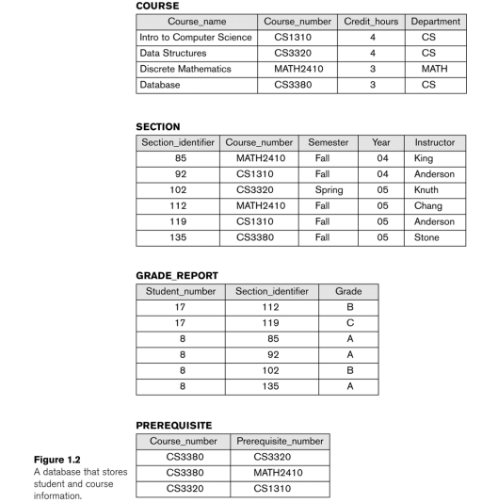
Example of a Simple Database

Slide 4
Main Characteristics of the Database Approach
DBMS catalog: stores the description of a particular database (e.g. data structures, types, and constraints)
Meta-data: The description of the data stored in a database (Data about data)
A data model: is used to hide storage details and present the users with a conceptual view of the database
Database views: Each user may see a different view of the database, which describes only the data of interest to that user

Slide 5
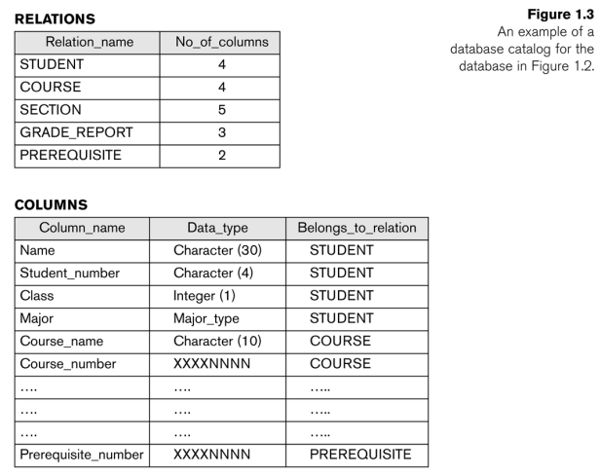

Example of a Database Catalog

Slide 6
Main Characteristics of the Database Approach
Allowing a set of concurrent users (multiple users) to retrieve from and to update the database.
Concurrency control: within the DBMS guarantees that each transaction is correctly executed or aborted
Recovery subsystem: ensures each completed transaction has its effect permanently recorded in the database
OLTP (Online Transaction Processing): is a major part of database applications. This allows hundreds of concurrent transactions to execute per second.

Slide 7
Database Users
Users may be divided into:
Actors on the Scene: Those who actually use and control the database content, and those who design, develop and maintain database applications
Workers Behind the Scene: Those who design and develop the DBMS software and related tools, and the computer systems operators

Slide 8
Database Users – Actors on the Scene
Database administrators: Responsible for authorizing access to the database, for coordinating and monitoring its use, acquiring software and hardware resources, controlling its use and monitoring efficiency of operations
Database Designers: Responsible to define the content, the structure, the constraints, and functions or transactions against the database. They must communicate with the end-users and understand their needs
End-users: They use the data for queries, reports and some of them update the database content.
Casual: access database occasionally when needed
Naïve or Parametric: they make up a large section of the end-user population.
Users of Mobile Apps, bank-tellers, reservation clerks, social media users

Slide 9
Database Users – Actors on the Scene
System Analysts and Application Developers: This category currently accounts for a very large proportion of the IT work force.
System Analysts: They understand the user requirements of naïve and sophisticated users and design applications including canned transactions to meet those requirements.
Application Programmers: Implement the specifications developed by analysts and test and debug them before deployment.
Business Analysts: There is an increasing need for such people who can analyze vast amounts of business data and real-time data (“Big Data”) for better decision making related to planning, advertising, marketing etc.

Slide 10
Database Users – Actors behind the Scene
System Designers and Implementors: Design and implement DBMS packages in the form of modules and interfaces and test and debug them. The DBMS must interface with applications, language compilers, operating system components, etc.
Tool Developers: Design and implement software systems called tools for modeling and designing databases, performance monitoring, prototyping, test data generation, user interface creation, simulation etc. that facilitate building of applications and allow using database effectively.
Operators and Maintenance Personnel: They manage the actual running and maintenance of the database system hardware and software environment.

Slide 11
Advantages of Using the Database Approach
Controlling redundancy in data storage and in development and maintenance efforts.
Sharing of data among multiple users.
Restricting unauthorized access to data. Only the DBA staff uses privileged commands and facilities.
Providing persistent storage for program Objects
Providing Storage Structures (e.g. indexes) for efficient Query Processing
Providing optimization of queries for efficient processing.
Providing backup and recovery services.
Providing multiple interfaces to different classes of users.
Representing complex relationships among data.
Enforcing integrity constraints on the database.

Slide 12
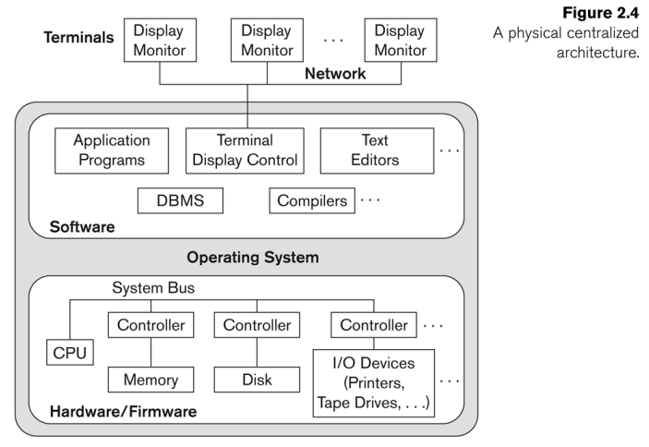
Centralized and Client-Server DBMS Architectures
Centralized DBMS:
Combines everything into single system including DBMS software, hardware, application programs, and user interface processing software.
User can still connect through a remote terminal – however, all processing is done at centralized site.

Slide 13
Client-server Architecture
Clients:
Provide appropriate interfaces through a client software module to access and utilize the various server resources
Connected to the servers via some form of a network.
(LAN: local area network, wireless network, etc.)
DBMS Server:
Provides database query and transaction services to the clients
Relational DBMS servers are often called SQL servers, query servers, or transaction servers
Applications running on clients utilize an Application Program Interface (API) to access server databases via standard interface such as: JDBC: for Java programming access

Slide 14
Three Tier Client-Server Architecture
Common for Web applications
Intermediate Layer called Application Server or Web Server:
Stores the web connectivity software and the business logic part of the application used to access the corresponding data from the database server
Acts like a conduit for sending partially processed data between the database server and the client.
Three-tier Architecture Can Enhance Security:
Database server only accessible via middle tier
Clients cannot directly access database server
Clients contain user interfaces and Web browsers
The client is typically a PC or a mobile device connected to the Web

Slide 15
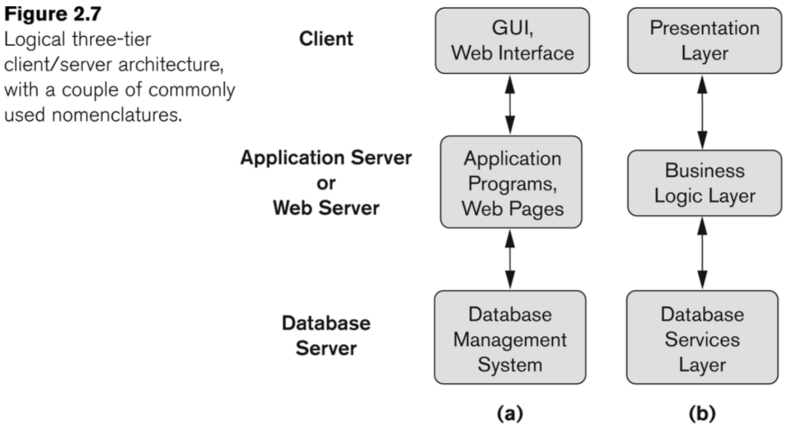
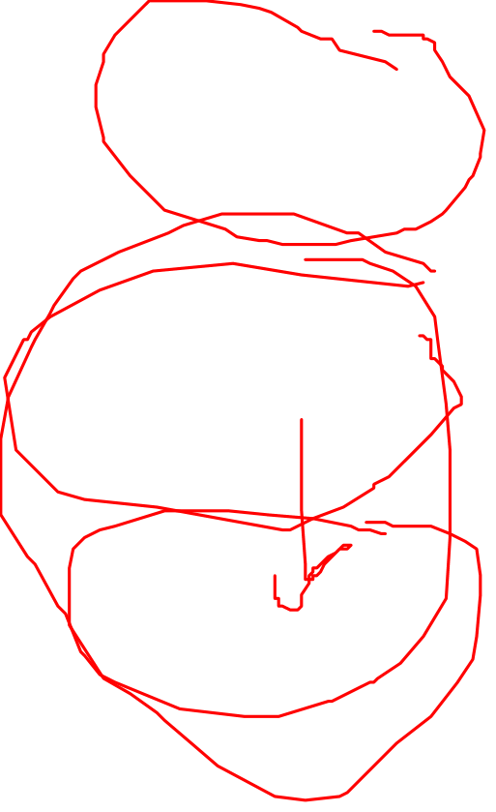
Three Tier Client-Server Architecture

